Slide 1
TechnoStress in digital age
Presented By:
Bsdsf21a010 Eman Zahid
Bsdsf21a022 Zoha Emaan
Bsdsf21a026 Zobia Bilal
Bsdsf21a040 Barira Sajjad

Slide 2
Motivation
03
04
In this digital age, technology has become an integral part of our lives, impacting everything from work to personal well-being.
Analyze the relationship between technostress and mental health issues like anxiety, depression, and burnout.

Slide 3
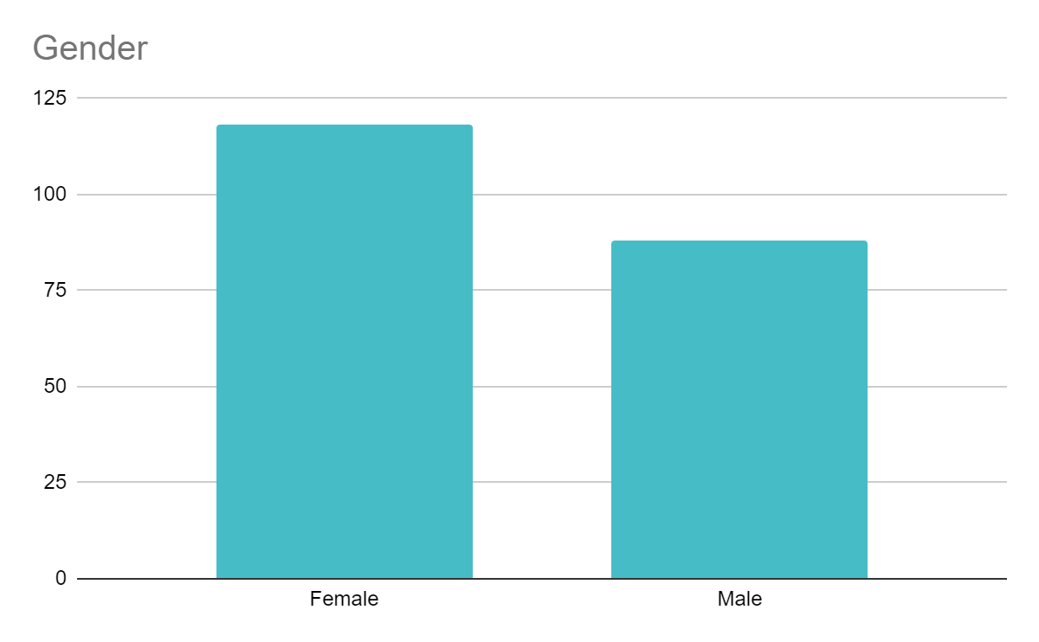
Target 206
Gender
42.7%
57.3%

Slide 4
Analysis
Null Hypothesis: The sequence is random.
Alternative Hypothesis: The sequence is not random.
Run Test Of Randomness

Slide 5
Analysis
Test of randomness is used for gender analysis.
Runs: 99
n1:118 (Female)
n2: 88 (Male)
z= -0.4019
-1.96< -0.4019 <1.96
Conclusion: Accept Null Hypothesis. The sequence is random.

Slide 6
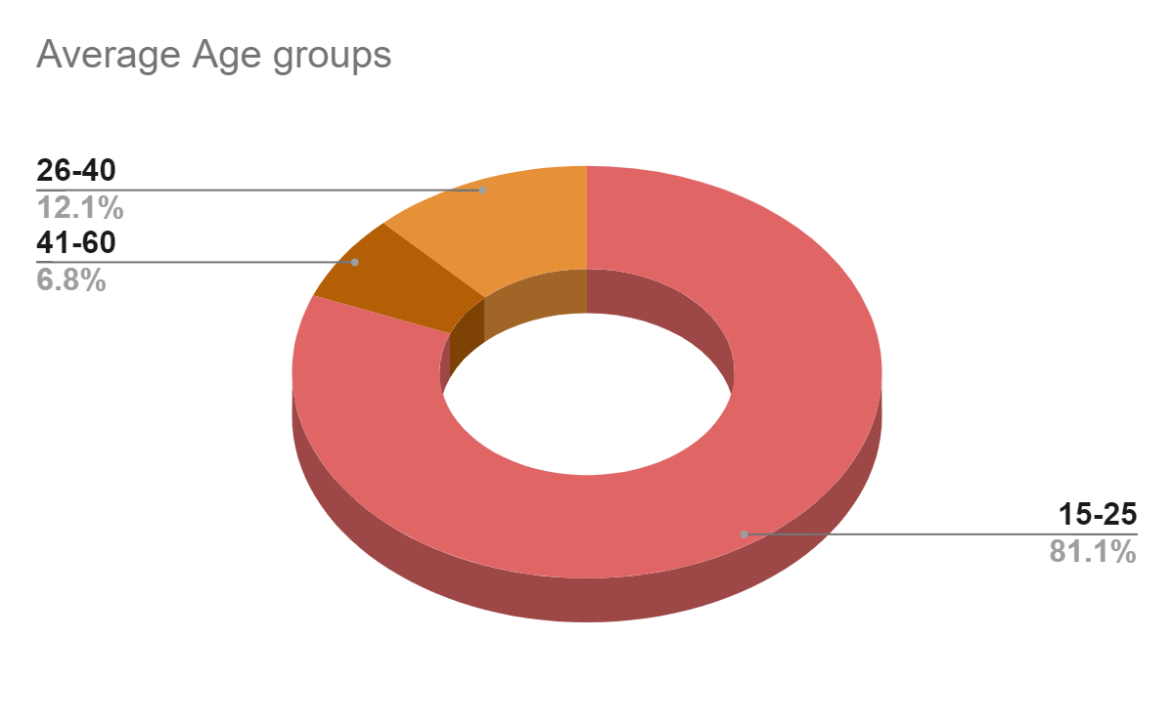
Age group

Slide 7
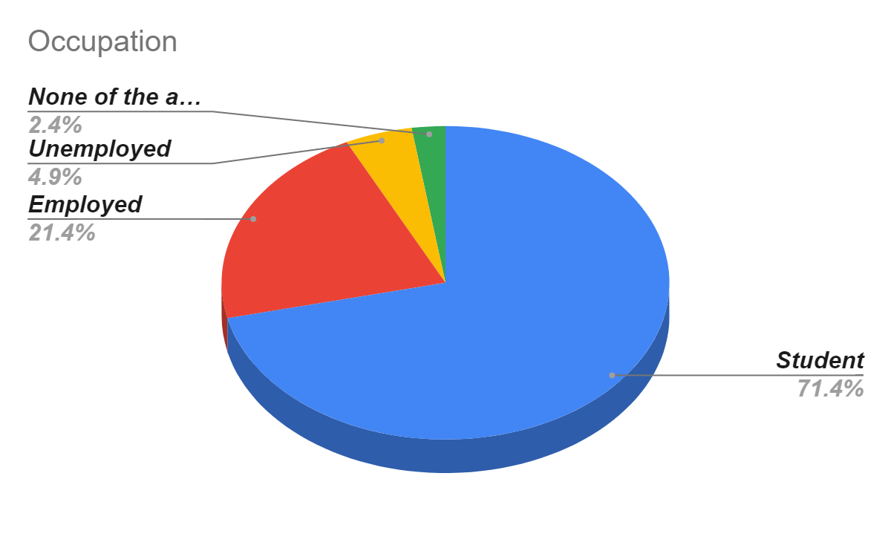
Occupation

Slide 8

Q#1 Highest level of education completed?
Occupation
Null Hypothesis: There is no significant association between education and occupation.
Alternative Hypothesis:There is a significant association between education and occupation.
Chi - Square Test Of Independence

Slide 9
Analysis
Computations are done using python codes.
Chi-square Test Statistic: 111.87676025841222
P-value: 6.097332310282753e-20
Or
0.0000000000000000000609733231082753
Alpha: 0.05
Conclusion: Reject Null Hypothesis

Slide 10
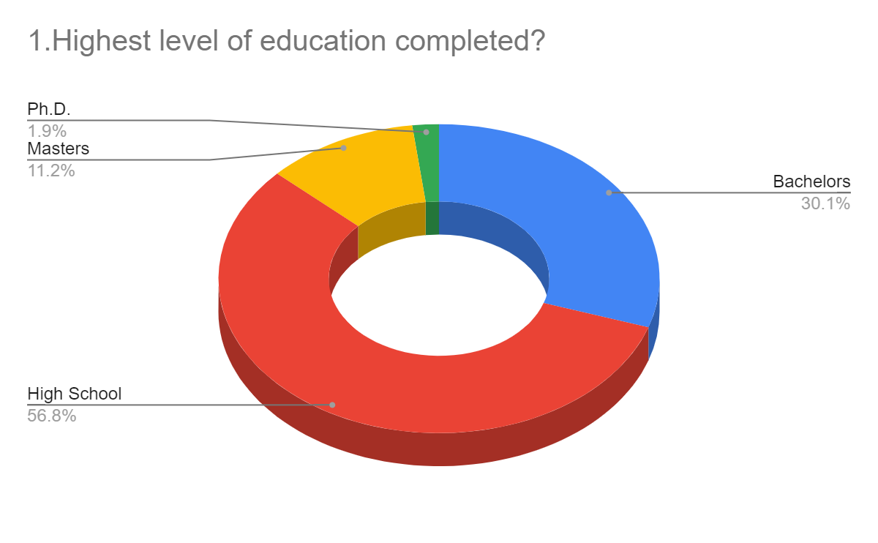
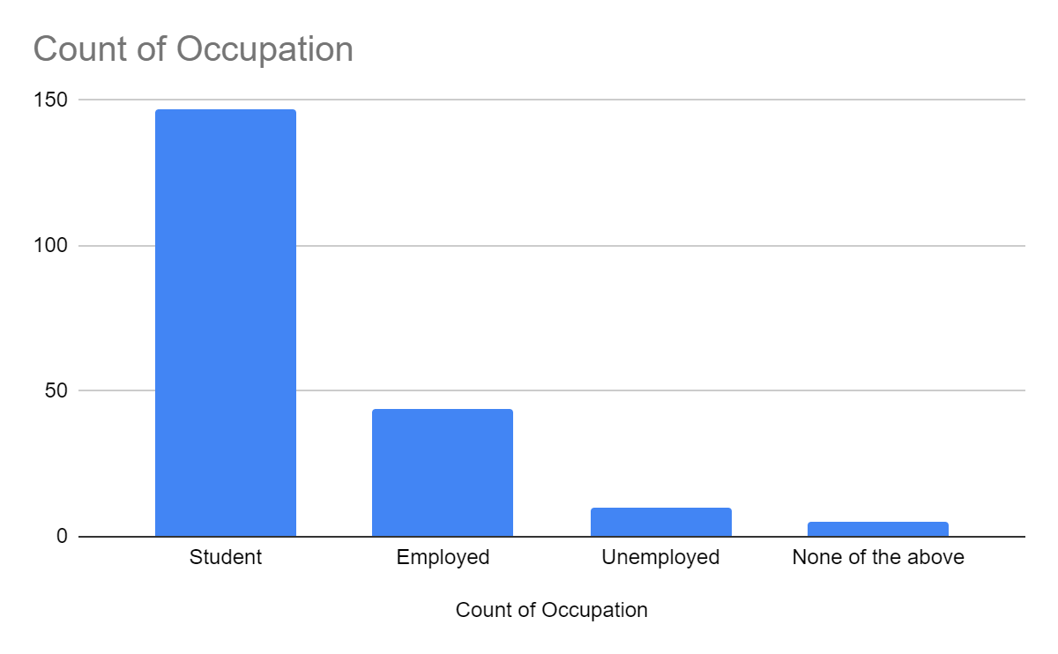
Graphical Representation
Day 1
Day 3

Slide 11
Q#2 On average how many hours per day do you use digital devices?
Null Hypothesis: The distribution of device usage across categories follows an equal distribution.
Alternative Hypothesis:The distribution of device usage across categories does not follow an equal distribution.
Chi Square Goodness Of Fit Test

Slide 12

Analysis
Computations are done using python codes.
Chi-Square Statistic: 31.671929750661054
P-value: 6.136491354819683e-07
Alpha: 0.05
Conclusion:
Reject the null hypothesis: There is significant evidence that the distribution differs.

Slide 13
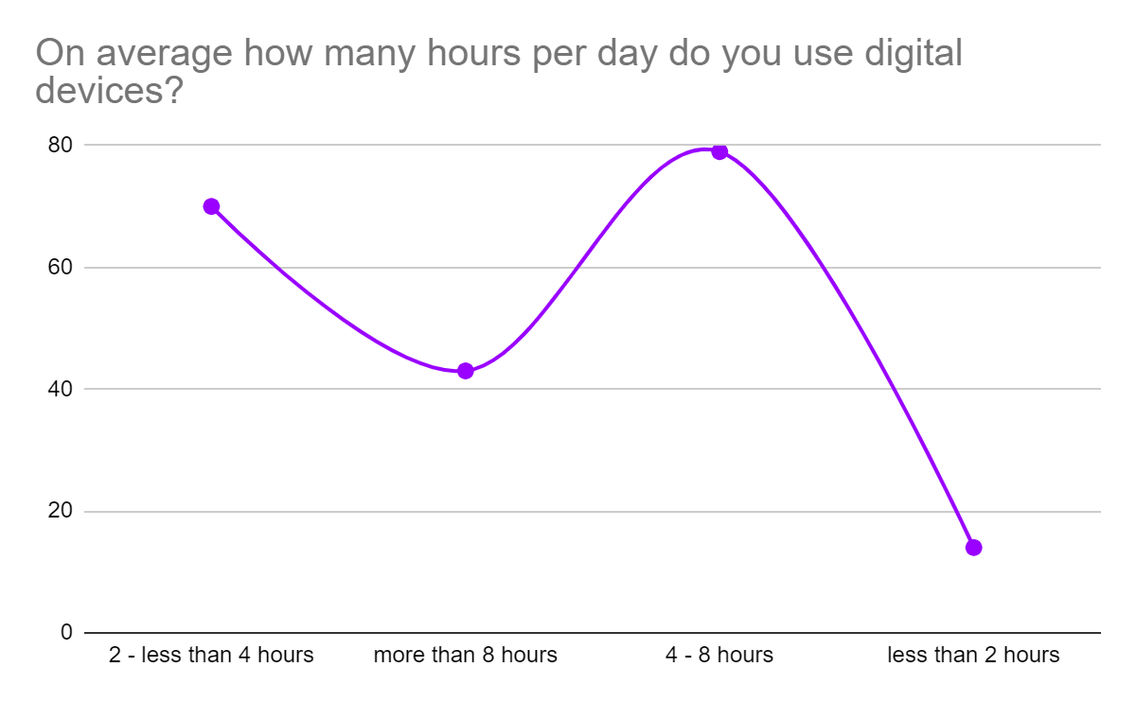
Graphical Representation
$20K
1%
45K

Slide 14
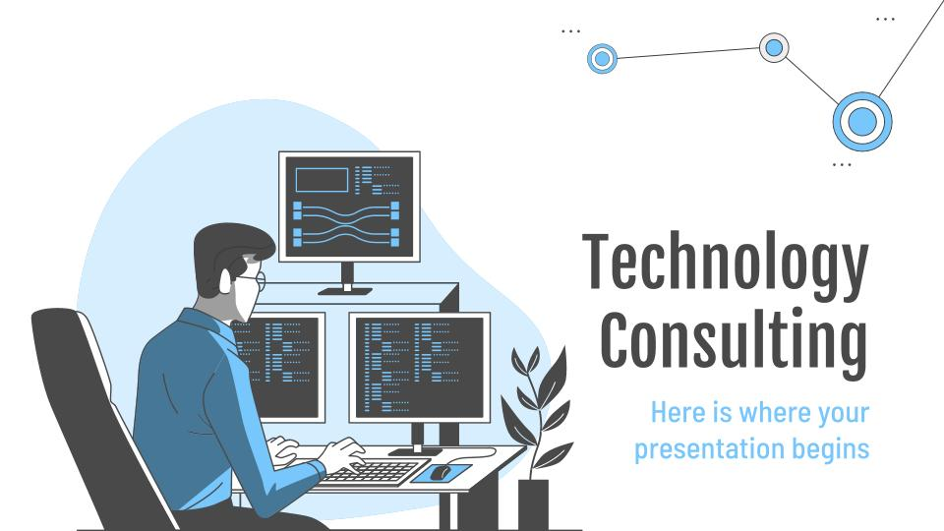
Q#3 + Q#4
Chi - Square Test Of Independence
Q#3 Which of the following technostress do you experience frequently?
Q#4 How do you typically cope with technostress?

Slide 15
Null Hypothesis: There is no significant association between technostress experience and coping mechanism.
Alternative Hypothesis:There is a significant association between technostress experience and coping mechanism
Analysis
Computations are done using python code
Chi-square Test Statistic: 38.41145439710537
P-value: 0.042154433815693296 Alpha:0.05
Conclusion:Reject Null Hypothesis

Slide 16
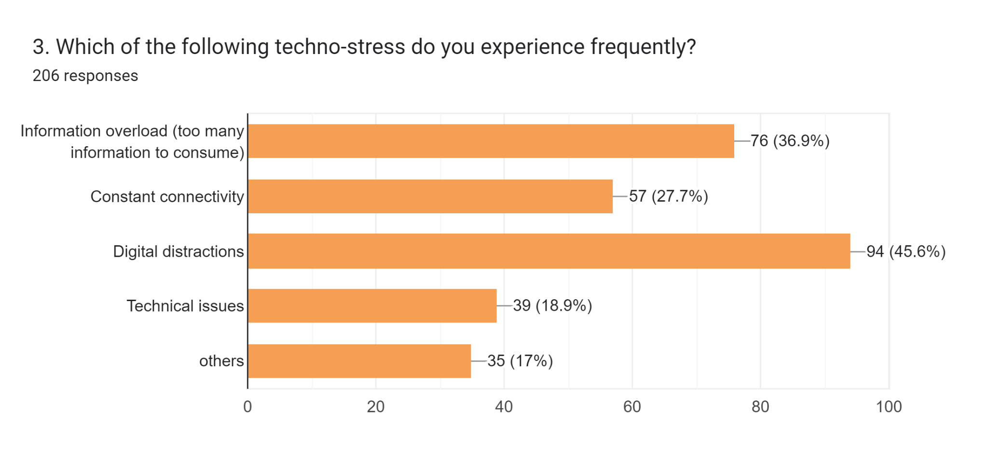
Graphical Representation

Slide 17
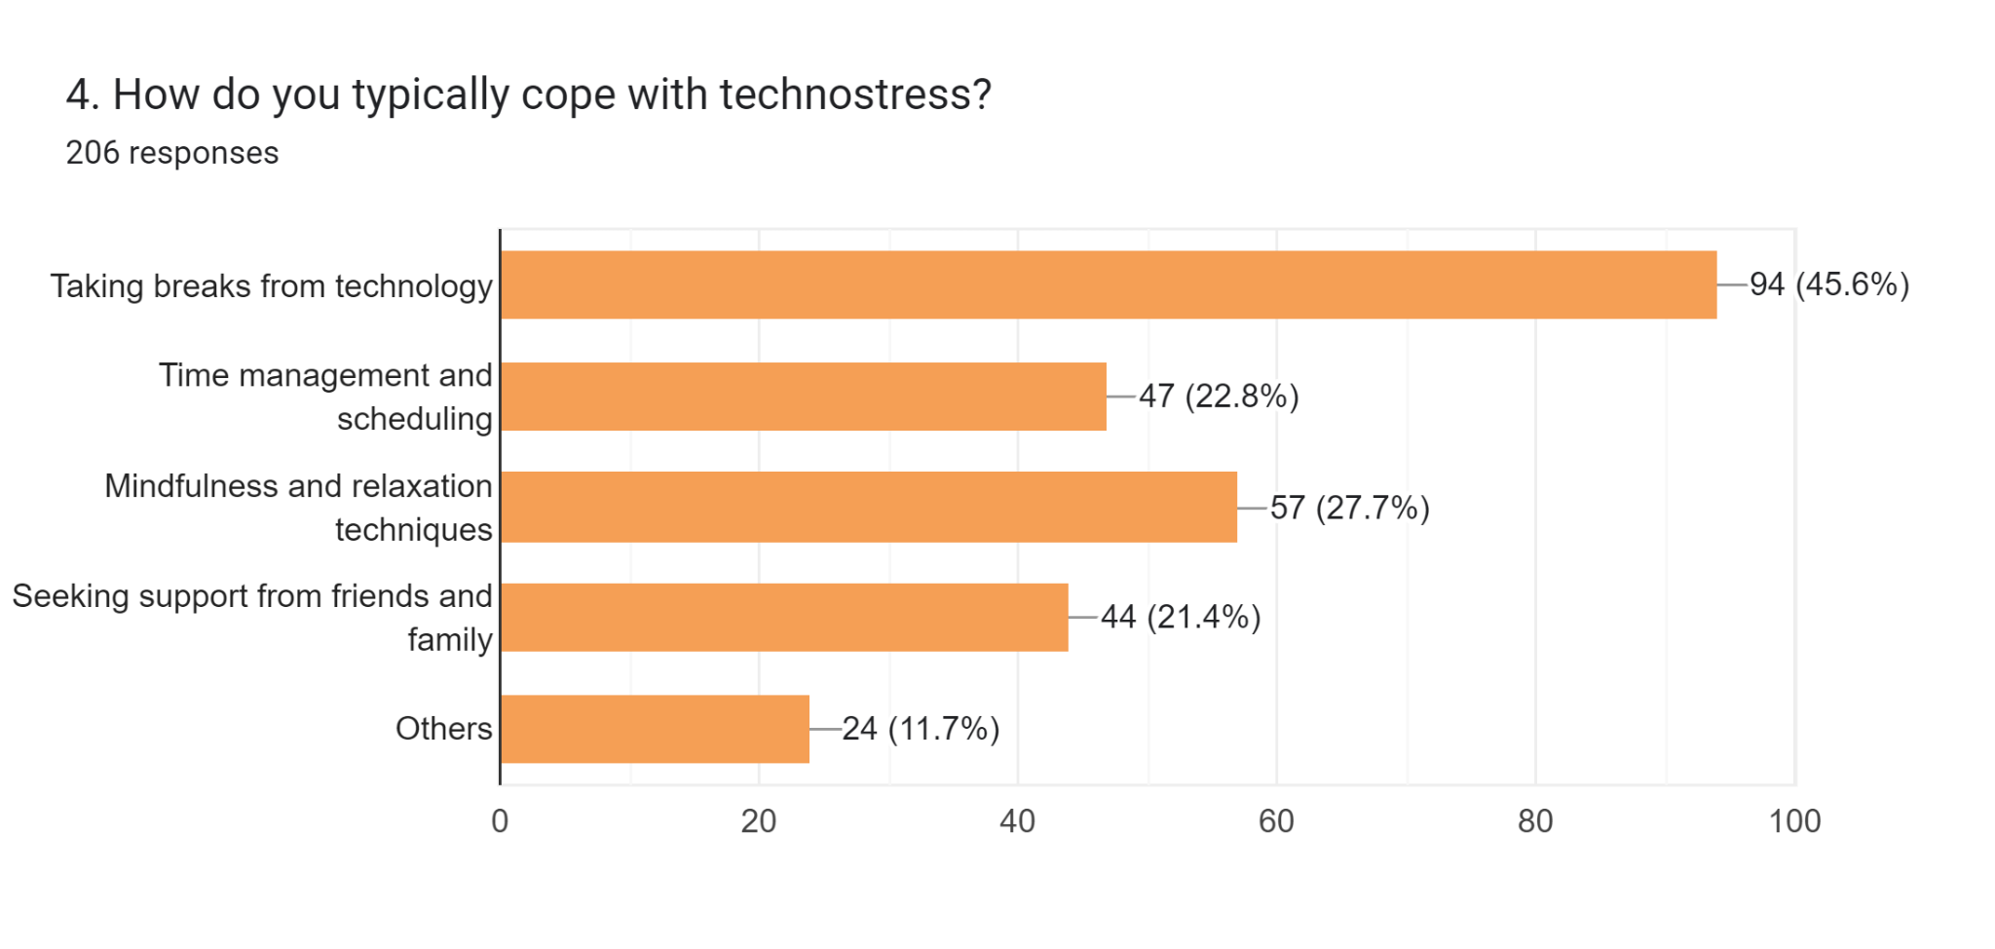
Graphical Representation

Slide 18
Q#5: Have you ever experienced any mental or physical health effects due to technostress?
Hypothesis Testing- Z-score test
Null Hypothesis: The population mean is 0.60.
Alternative Hypothesis: The population mean is less than 0.60.

Slide 19
Analysis
Computations are done using python code.
P-value: 0.2857138653541216
Alpha:0.05
Z-Score: -1.8675714553417663
Conclusion:Accept Null Hypothesis

Slide 20
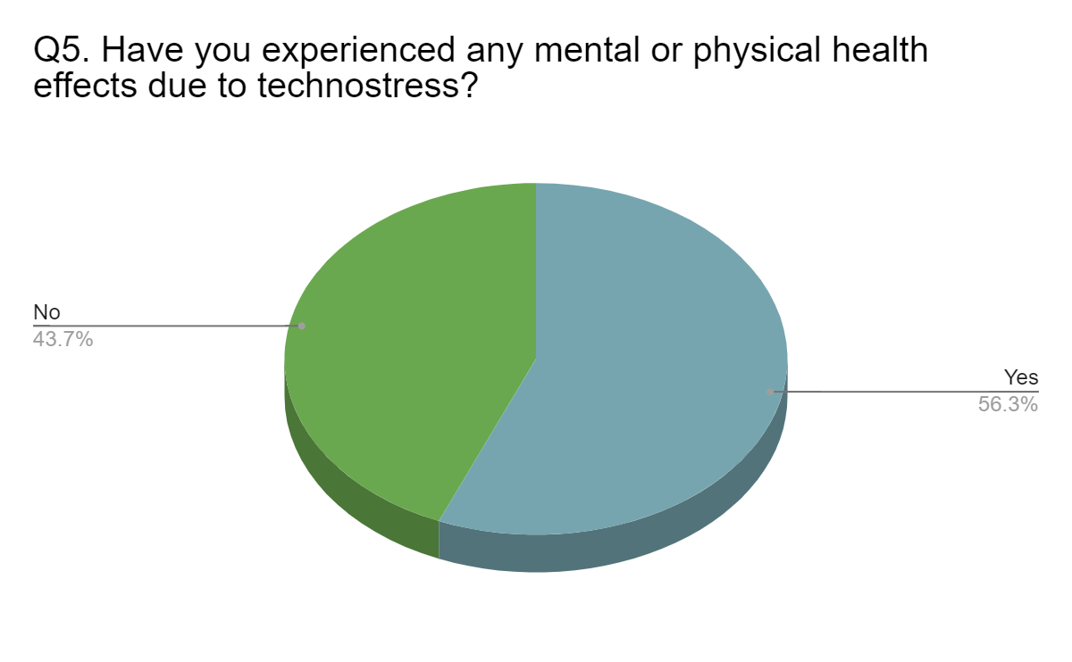
Graphical Representation

Slide 21
Q#6: How frequently have you experienced technostress due to cyberbullying?
Q#7: How did technostress affect you emotionally and psychologically?
Linear Correlation
Null Hypothesis: No correlation.
Alternative Hypothesis: Correlation exists.

Slide 22
Analysis
Computations are done using python code.
P-value: 0.7027
Alpha:0.05
r: -0.0267
0.7027<=0.05 (False)
Conclusion: Accept Null Hypothesis. There is no linear correlation.

Slide 23
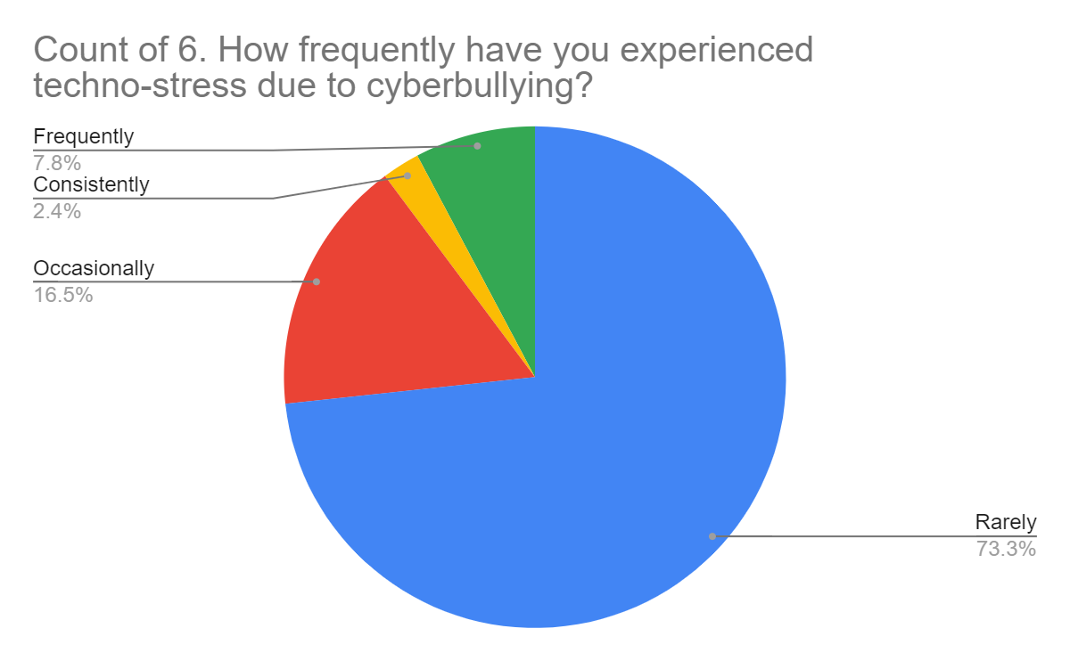
Graphical Representation

Slide 24
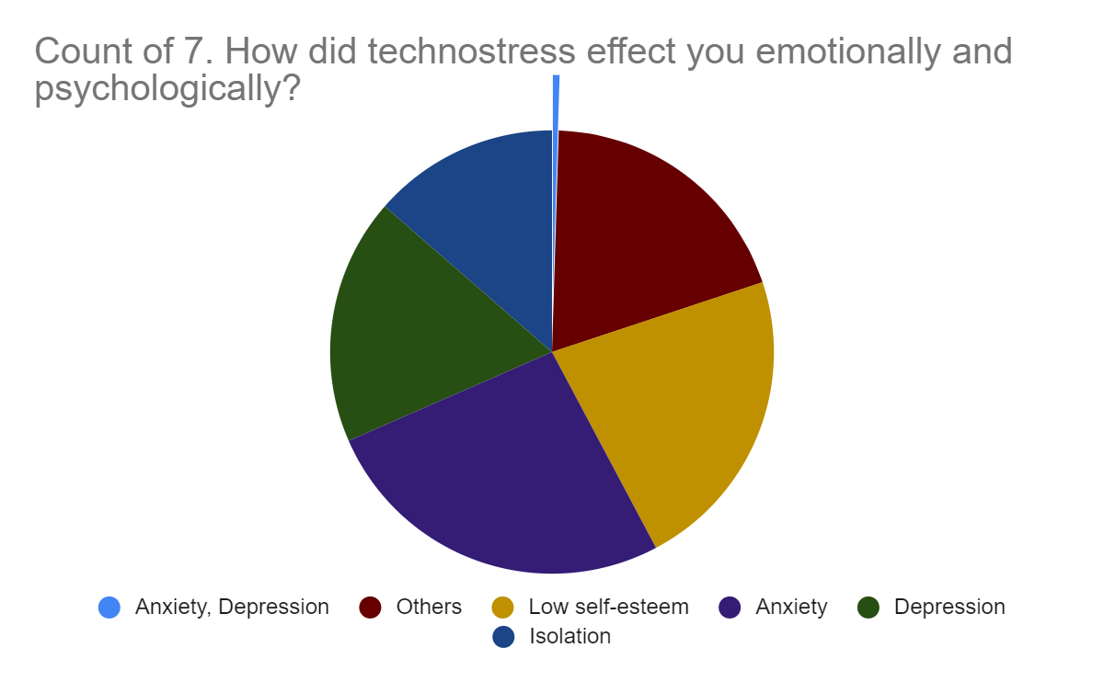
Graphical Representation

Slide 25
Q#8 + Q#3
Chi - Square Test Of Independence
Q#8 Which are the apps that cause the most stress?
Q#3 Which of the following technostress do you experience frequently?

Slide 26
Null Hypothesis: There is no joint association between the frequency of experiencing technostress and the choice of apps causing stress.
Alternative Hypothesis:There is a significant joint association between the frequency of experiencing technostress and the choice of apps causing stress.
Analysis
Computations are done using python code
Chi-square Test Statistic:17.242855779751157
P-value: 0.37005283065413647 Alpha:0.05
Conclusion: Accept Null Hypothesis.

Slide 27
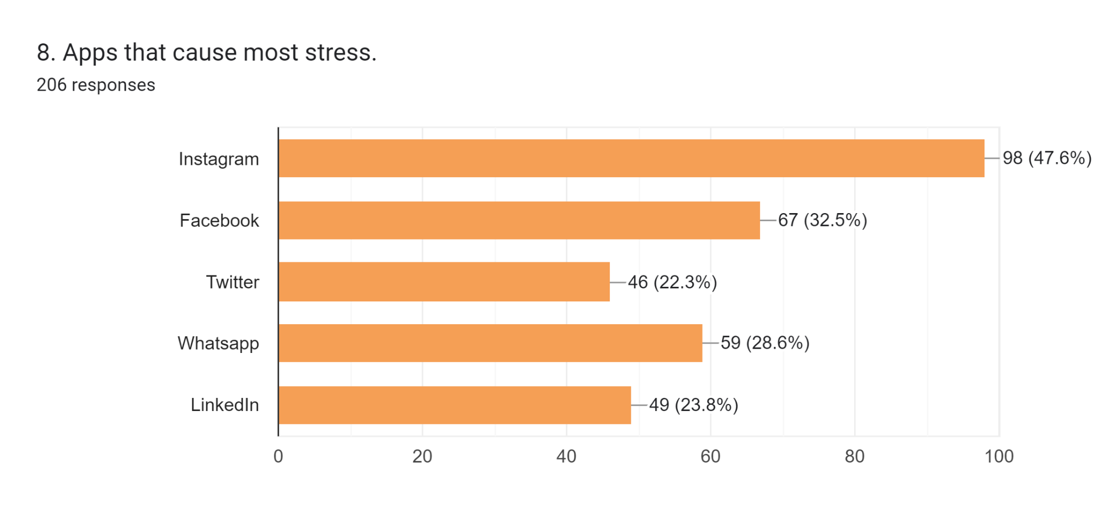
Graphical Representation

Slide 28
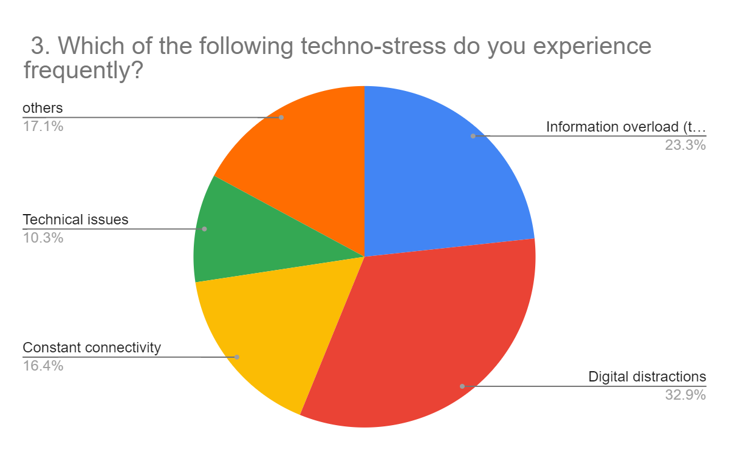
Graphical Representation

Slide 29
Question # 09
Hypothesis Testing- Z-score test
Q#9 What type of cyberbullying do you think is the most common?
Null Hypothesis: The population mean for trolling or offensive comments is 0.36
Alternative Hypothesis: The population mean for trolling or offensive comments is less than 0.36

Slide 30
Cyberbullying
Trolling and offensive comments
Harassment and threats
Image based harassment

Slide 31
Analysis
Computations are done using python codes.
Z-Score: 0.121631655
P-value: 0.903190742
Alpha:0.05
Conclusion:Fail to reject Null Hypothesis

Slide 32
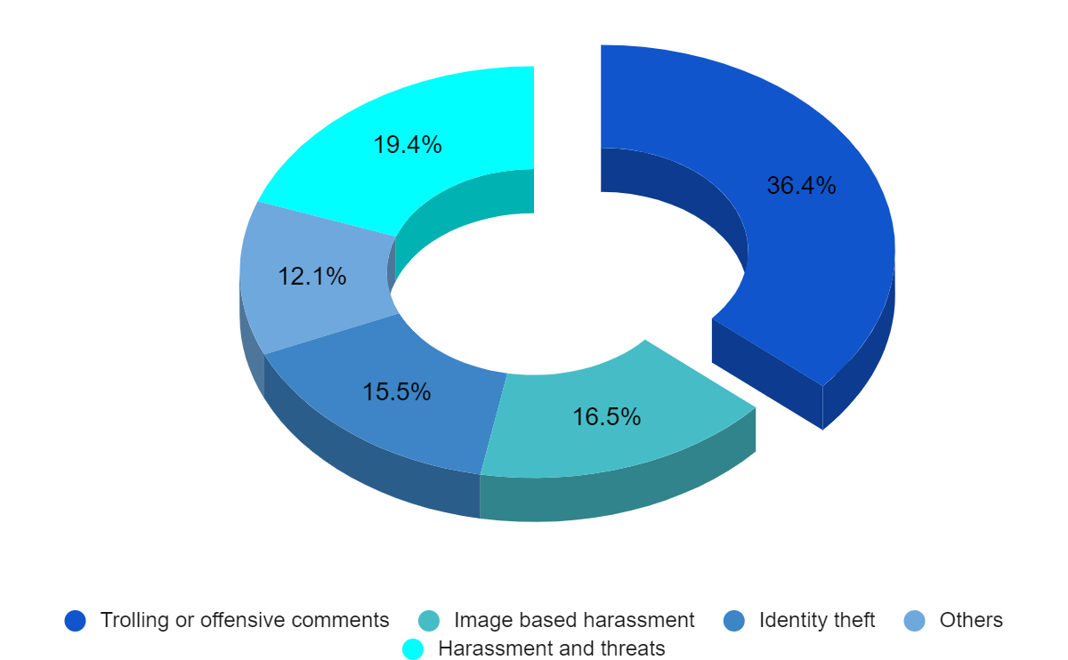
Graphical Representation

Slide 33
Question #10
Ahhh! No words to explain……..
I hate my phone, which took my all relatives from me 😭
Maintain your streaks in your papers is the biggest techno stress!
I think techno stress is an uprooting issue which needs to be dealt. People are not aware of this rising issue they need to be educated on this.
It provides more easiness to people who want to earn money and do something.
Social media platforms are life saving drugs for freelancers!!!

Slide 34
Thanks!
Please keep this slide for attribution

